Slide 1
Software Testing
Software Engineering | SDLC V-Model
Software Engineering

Slide 2
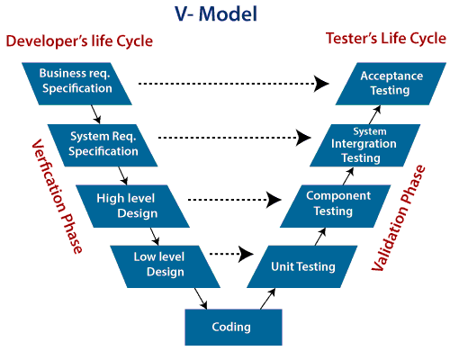
V Model

Slide 3
V Model
In the V model, the development and QA activities are done simultaneously.
There is no discrete phase called Testing, rather testing starts right from the requirement phase.
The verification and validation activities go hand in hand.
Verification: Verification is a static analysis technique. In this technique, testing is done without executing the code. Examples include – Reviews, Inspection, and walkthrough.
Validation: Validation is a dynamic analysis technique where testing is done by executing the code. Examples include functional and non-functional testing techniques.

Slide 4
Business Requirement Analysis
This is the first phase in the development cycle where the product requirements are understood from the customer’s perspective.
This phase involves detailed communication with the customer to understand his expectations and exact requirement.
This is a very important activity and needs to be managed well, as most of the customers are not sure about what exactly they need.
The acceptance test design planning is done at this stage as business requirements can be used as an input for acceptance testing.

Slide 5
System Design
Once you have the clear and detailed product requirements, it is time to design the complete system.
The system design will have the understanding and detailing the complete hardware and communication setup for the product under development.
The system test plan is developed based on the system design. Doing this at an earlier stage leaves more time for the actual test execution later.

Slide 6
Architectural Design
Architectural specifications are understood and designed in this phase. Usually more than one technical approach is proposed and based on the technical and financial feasibility the final decision is taken.
The system design is broken down further into modules taking up different functionality. This is also referred to as High Level Design (HLD).
The data transfer and communication between the internal modules and with the outside world (other systems) is clearly understood and defined in this stage.
With this information, integration tests can be designed and documented during this stage.

Slide 7
Module Design
In this phase, the detailed internal design for all the system modules is specified, referred to as Low Level Design (LLD).
It is important that the design is compatible with the other modules in the system architecture and the other external systems.
The unit tests are an essential part of any development process and helps eliminate the maximum faults and errors at a very early stage.
These unit tests can be designed at this stage based on the internal module designs.

Slide 8
Coding Phase
The actual coding of the system modules designed in the design phase is taken up in the Coding phase. The best suitable programming language is decided based on the system and architectural requirements.
The coding is performed based on the coding guidelines and standards.
The code goes through numerous code reviews and is optimized for best performance before the final build is checked into the repository.

Slide 9
When to use the V-model:
The V-shaped model should be used for small to medium sized projects where requirements are clearly defined and fixed.
The V-Shaped model should be chosen when ample technical resources are available with needed technical expertise.

Slide 10
Pros and Cons of V-model:
PROS | CONS
- Development and progress is very organized and systematic | -Not suitable for bigger and complex projects
- Works well for smaller to medium sized projects. | - Not suitable if the requirements are not consistent.
- Testing starts from beginning so ambiguities are identified from the beginning. | - No working software is produced in the intermediate stage.
- Easy to manage as each phase has well defined objectives and goals. | - No provision for doing risk analysis so uncertainty and risks are there.

